Slide 1
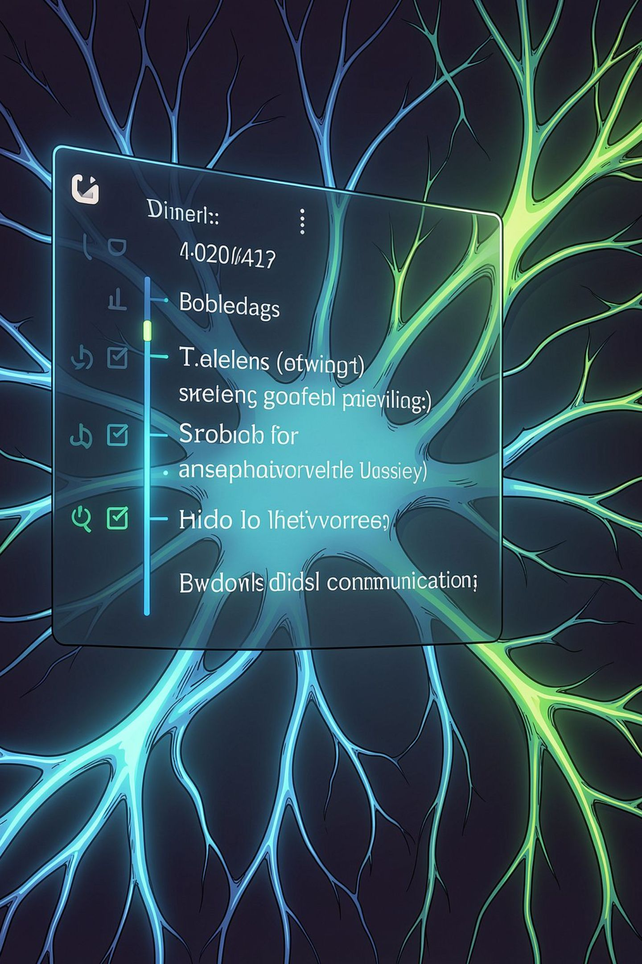
Next Word Prediction System
Leveraging Natural Language Processing and advanced language modeling to deliver intelligent, context-aware text predictions across modern digital communication platforms.
NLP · DEEP LEARNING · LANGUAGE MODELING

Slide 2





Why Next-Word Prediction Matters
Intelligent text prediction is now a core expectation across every digital interface. Context-aware models outperform static autocomplete by understanding grammar, semantics, and user intent.
Messaging Apps
Real-time suggestions reduce typing effort and accelerate conversations.
Search Engines
Predictive queries improve discoverability and reduce search friction.
Document Editors
Smart completions enhance writing flow and reduce errors.
Virtual Assistants
Contextual predictions enable natural, conversational interactions.

Slide 3
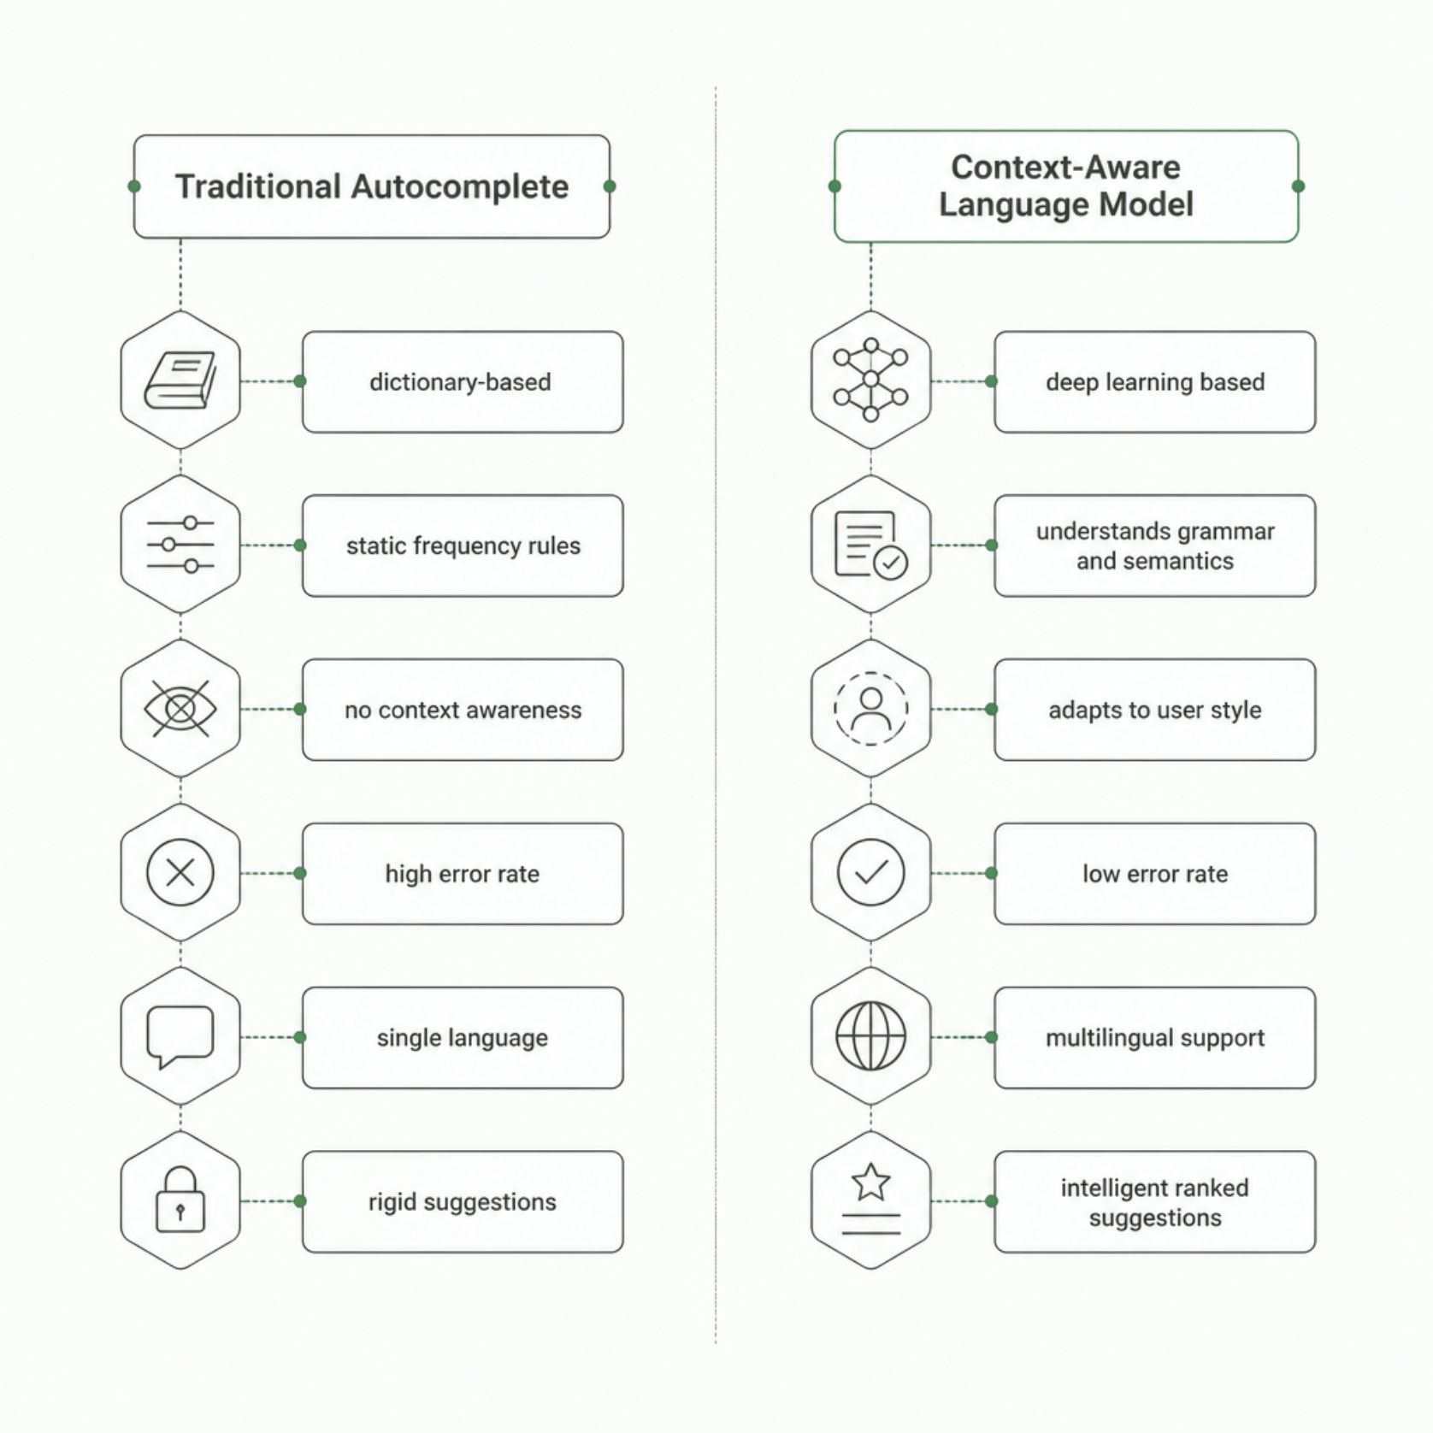

From Static Rules to Intelligent Context
The Paradigm Shift
Traditional autocomplete relies on dictionaries and static frequency tables — blind to sentence context, grammar, and user intent. Modern language models understand semantic meaning, adapt to writing style, and generate ranked predictions with confidence scores in real time.
Context-aware models reduce prediction error rates by up to 60% compared to frequency-based methods.

Slide 4
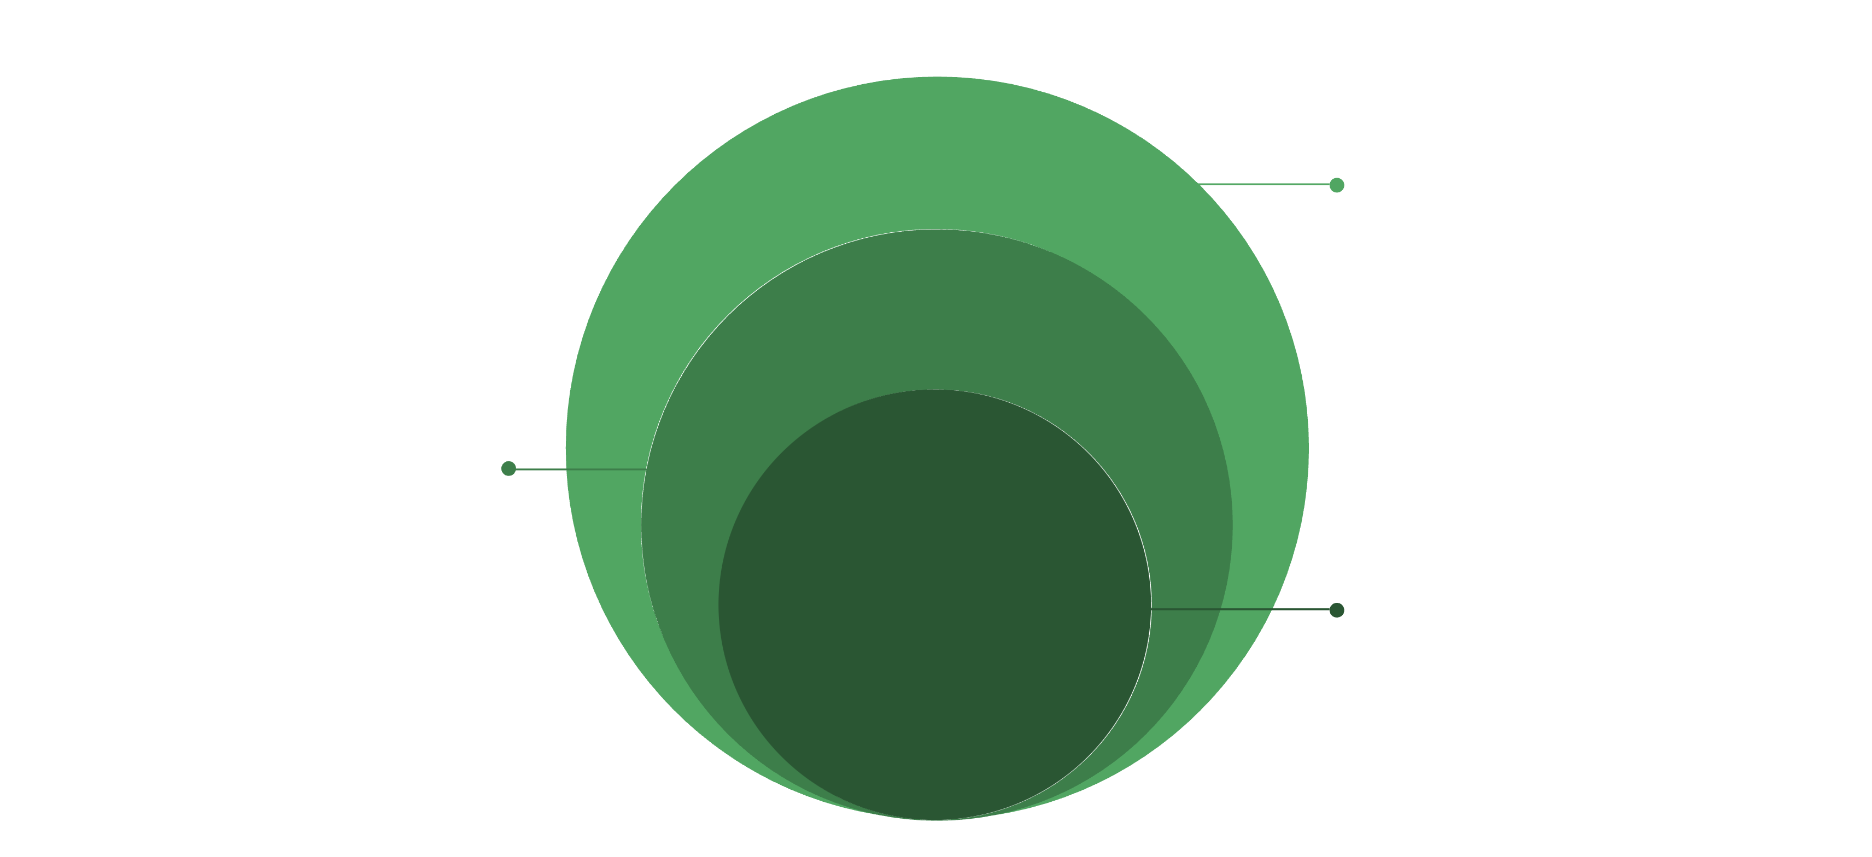
System Architecture
Presentation
Web, mobile and API access
Application
Authentication, input handling, analytics
Core NLP
Tokenization, embeddings, inference, scoring
The system separates concerns across four layers: a presentation layer for multi-device access, an application layer handling business logic and authentication, an NLP and language modeling layer performing tokenization, embedding generation, and model inference, and an infrastructure layer providing scalable cloud storage and model management.
User Authentication & Access Control
Text Preprocessing Engine
Secure login with role-based permissions for admin, analyst, and end-user roles.
Tokenization, stop-word handling, vocabulary mapping, and word embedding generation.
Language Model Inference
Analytics & Model Management
Real-time prediction with probability calculation and confidence scoring.
Performance dashboards, usage reporting, and continuous model retraining pipelines.

Slide 5

End-to-End Prediction Workflow
Inference & Ranking
Tokenization & Embedding
Input & Cleaning
Each user input traverses the full NLP pipeline in under 50 milliseconds. The system cleans raw text, maps tokens to vocabulary indices, generates dense vector embeddings, extracts contextual features, runs model inference, and returns ranked word predictions with confidence scores — all in a single continuous flow.
Tokenization
Embedding Layer
Confidence Scoring
WordPiece or BPE tokenization maps raw text to vocabulary indices.
Word2Vec, GloVe, or contextual embeddings encode semantic meaning.
Softmax probabilities rank predictions by likelihood and relevance.

Slide 6
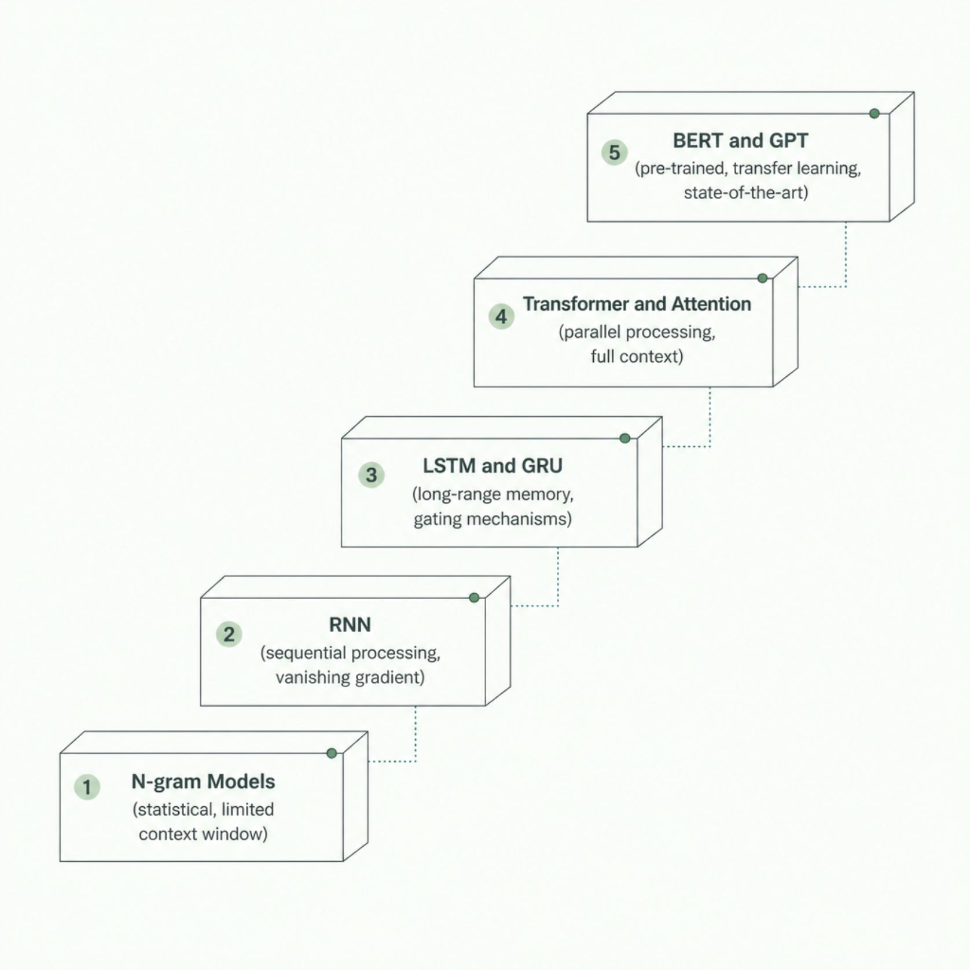

Language Modeling Approaches
From Statistics to Transformers
Language modeling has evolved from simple N-gram statistics to deep architectures capable of capturing long-range dependencies and nuanced semantics.
LSTM / GRU
Transformer & Attention
BERT / GPT
Gating mechanisms retain long-range context, ideal for sequential text.
Parallel processing and self-attention capture global dependencies efficiently.
Pre-trained models enable transfer learning and state-of-the-art accuracy.

Slide 7






Technology Stack
A modern, cloud-native stack integrates frontend, backend, NLP, and deep learning components into a secure, scalable platform.
Frontend
Backend
React / Vue.js, D3.js, Chart.js
Python, FastAPI / Flask, REST APIs
Deep Learning
Database
TensorFlow, PyTorch, Keras, Hugging Face
PostgreSQL, Redis, Elasticsearch
Cloud & DevOps
Security
AWS / GCP, Docker, Kubernetes, CI/CD
OAuth 2.0, JWT, TLS 1.3, RBAC

Slide 8
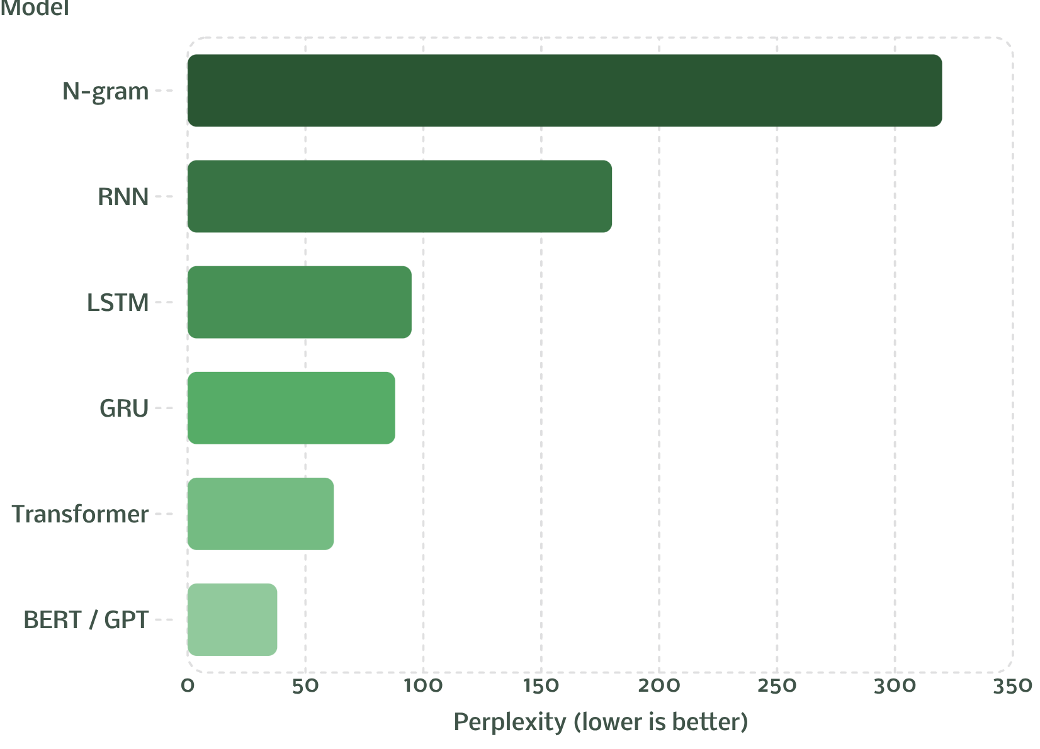
Model Performance & Evaluation
Key Evaluation Metrics
Perplexity measures how well a model predicts a sample — lower values indicate better generalization. Production systems also track inference latency, precision, recall, and F1-score.
Perplexity
Inference Latency
Precision / Recall
Primary metric for language model quality
Target <50 ms for real-time UX
Accuracy of top-N predictions

Slide 9



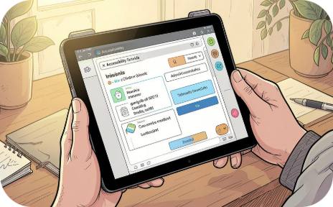
Real-World Applications & Key Advantages
Mobile Keyboards & Messaging
Email & Document Editors
Virtual Assistants & Search
Accessibility & Education
Reduces keystrokes by up to 40%, accelerating mobile communication.
Smart compose improves writing quality and reduces cognitive load.
Contextual predictions enable natural, conversational interactions.
Assists users with disabilities and supports language learners.

Slide 10


Challenges, Future Roadmap & Conclusion
Implementation Challenges
Future Enhancements
Ambiguity & Context: Resolving multi-meaning sentences via attention mechanisms.
Large language model integration (LLM-as-a-service)
Personalized, adaptive user-level models
Real-time grammar correction and sentence completion
Speech-to-text prediction and voice assistant integration
Explainable AI for transparent predictions
Cloud-native, mobile-optimized edge deployment
Latency at Scale: Model quantization and edge AI for sub-50 ms inference.
Privacy & Multilingual Support: Federated learning and on-device processing.
This system delivers accurate, context-aware predictions that enhance typing efficiency, improve writing quality, and scale across AI-powered communication platforms.

